Slide 1

Government democracy versus people’s democracy: lessons from post apartheid boundary disputes
By Mazembo Mavungu Eddy
Phd Candidate
Political studies / University of the Witwatersrand
Johannesburg/ South Africa

Slide 2
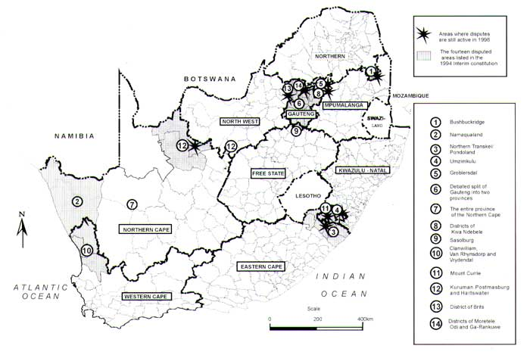
Where are Khutsong and Matatiele situated ?

Slide 3
Local government restructuring process in Post apartheid South Africa
1993 : the process of demarcation of new provinces – 9 provinces, but at least 14 disputed areas
1994 – 2000 : Transitional local authorities
2000: a process of consolidation reduces the number of municipalities from 843 to 284
The process also creates 16 cross boundary municipalities
But cross boundary municipalities prove to be inefficient. Hence the decision to get rid of them in 2005.
2005-2009: Disputes as to which province some cross boundary municipalities (Merafong, Matatiele, Moutse) would fall under.

Slide 4
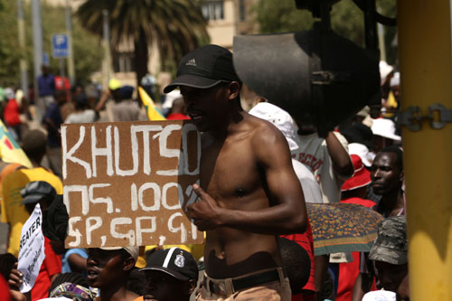
1. The Khutsong case study

Slide 5
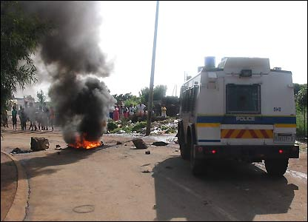
1. The Khutsong case study

Slide 6
1. The Khutsong case study
The majority of residents in support of Gauteng rather than North West for service delivery, functional, and developmental reasons
Government wants them in North West to balance population size between the two provinces and better “equitable share” for North West
Government ignores residents’ preferences from 2005 to 2008 despite protests and violence against the state
The township rendered ungovernable: riots, burning of councilors’ houses, divisions with ANC and the alliance, etc…
The constitutional court fails to satisfy aggrieved residents
Policy reversal in late 2008 as a result of: leadership change in the ANC, Mbeki’s recall, and 2009 general elections
The new ANC leadership: “ We made a mistake… People shall govern”

Slide 7
2. The Matatiele case study
The dispute is a legacy of apartheid spatial segregation and ethnic antagonism
In 2005, government decides to unify Matatiele and its rural villages and include the unit in Eastern Cape. But the move sparks resistance
Also deep disagreement among residents:
Pro-KZN base their preferences on service delivery, functional, economic, development arguments
Pro-EC base their preferences on culture and history arguments with support from most ANC councillors and traditional authorities
Three constitutional court challenges have failed to resolve the matter
The new ANC leadership has taken a new approach by organizing a referendum on the matter, but the exercise has failed to appear free and fair.
The new ANC leadership still to make a decision on the matter. Some local leaders propose the scrapping of provinces as the best solution to this problem.

Slide 8
3. Broad patterns
Functional regional planning versus territorial regional planning
Representative democracy versus direct democracy
Conflicting conceptions of public participation in the legislative process

Slide 9
Thank you
Questions and comments are
welcome
Eddy Mazembo Mavungu
PhD candidate
Political Studies
University of the Witwatersrand
mazembo.mavungu@students.wits.ac.za

